Slide 1
WHITHER HUNTER?
Challenges and future opportunities
Dr Alan Rai
Principal Economist
Hunter Research Foundation

Slide 2
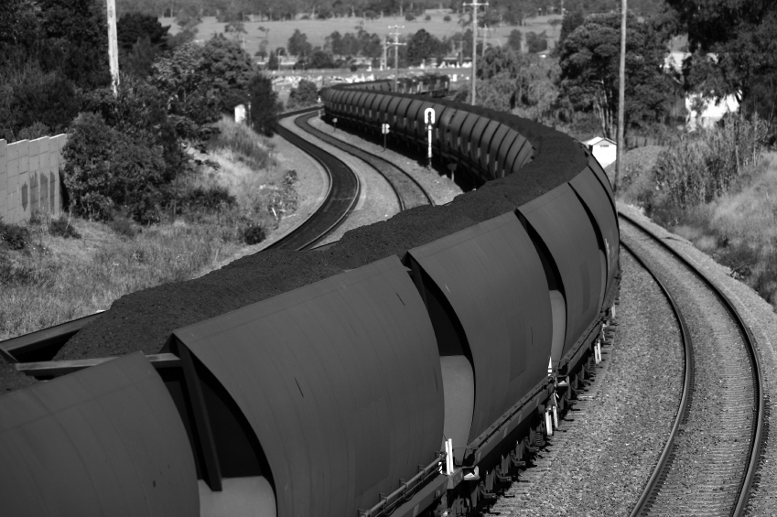
PRESENTATION OUTLINE
Current context
High unemployment
Green shoots?
Future opportunities
Focus on our comparative advantages
‘Think global, act local’

Slide 3
REGIONAL ECONOMY
A ‘pulse check’

Slide 4
CURRENT ECONOMIC CONTEXT
Still feeling the effects of end of mining boom
Unemployment high
Weak confidence
Green shoots exist
Lower A$: boosts our exporters
Reduced cost of living pressures
Improving household confidence
But will it translate into higher spending?

Slide 5
UNEMPLOYMENT
CONTINUES TO RISE
Hunter remains highly reliant on mining

Slide 6
Time for audience participation!

Slide 7
HOUSE PRICES IN…?
Within two hours of here….

Slide 8
HOUSE PRICES CLOSE TO HOME
BOOSTED BY LOW INTEREST RATES
Hunter Balance: Impacted by mining slowdown

Slide 9
BUILDING ON SHAKY GROUND
Clue: State vs Region

Slide 10
SYDNEY VS THE HUNTER
SOMETHING TO DWELL ON
High unemployment limits desire to build

Slide 11
ECONOMIC OUTLOOK
DIVERGING EXPECTATIONS
Lower cost of living pressures for households

Slide 12
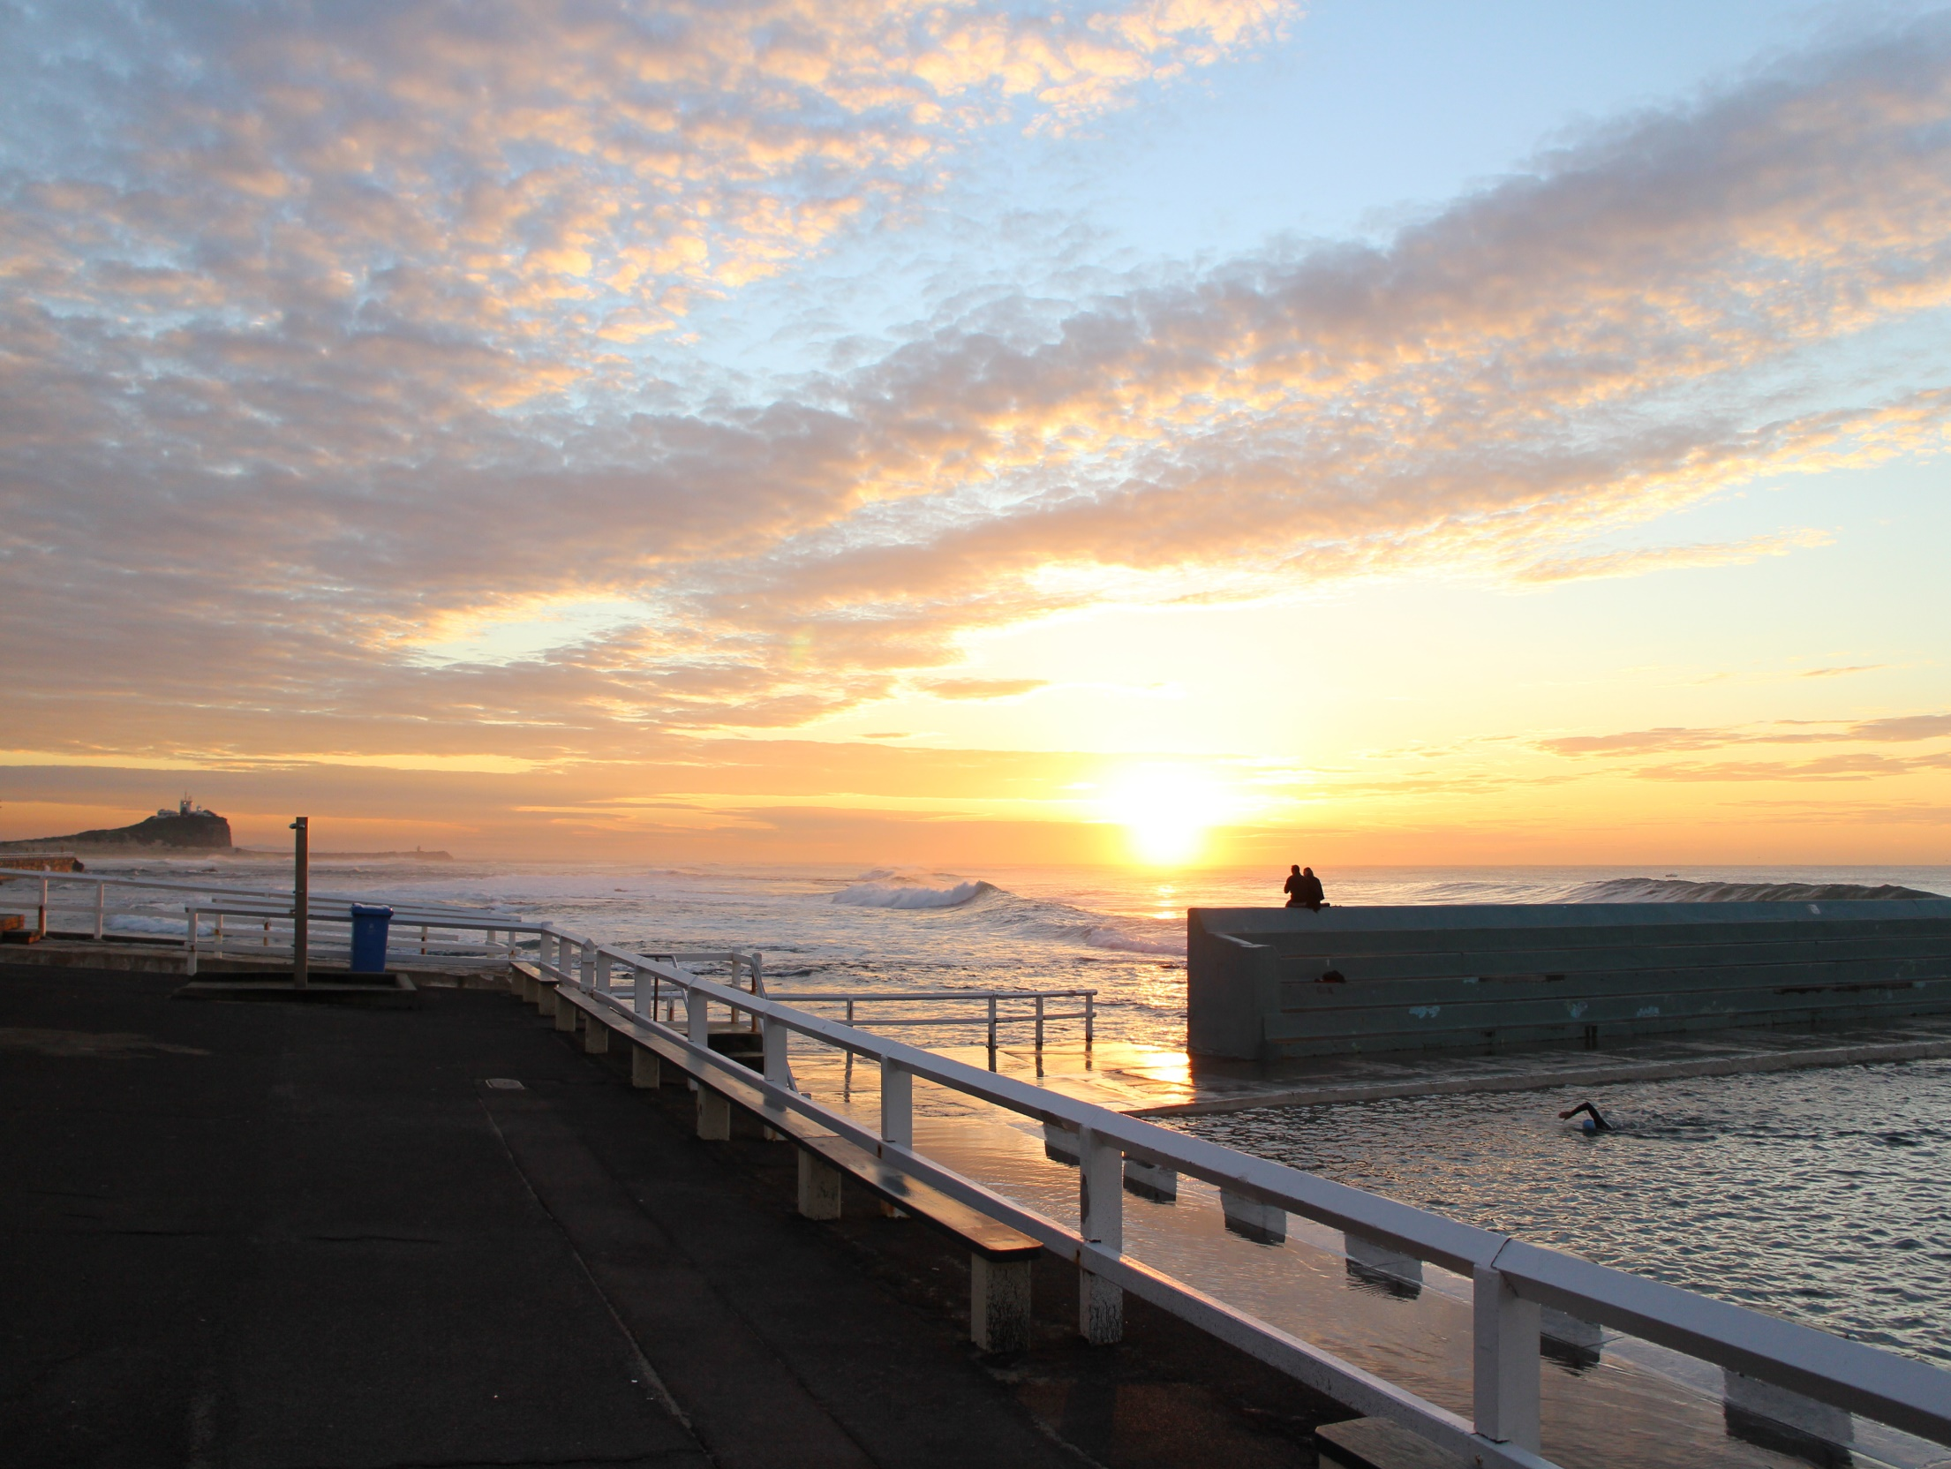
SUMMING UP
‘PULSE CHECK’ OF LOCAL ECONOMY
Economy remains highly reliant on mining
Unemployment remains high
(Weak) green shoots exist
Lower A$
Less intense cost of living pressures
Better household confidence
Will it result in higher spending?

Slide 13
OPPORTUNITIES FOR THE REGION
Post mining boom

Slide 14
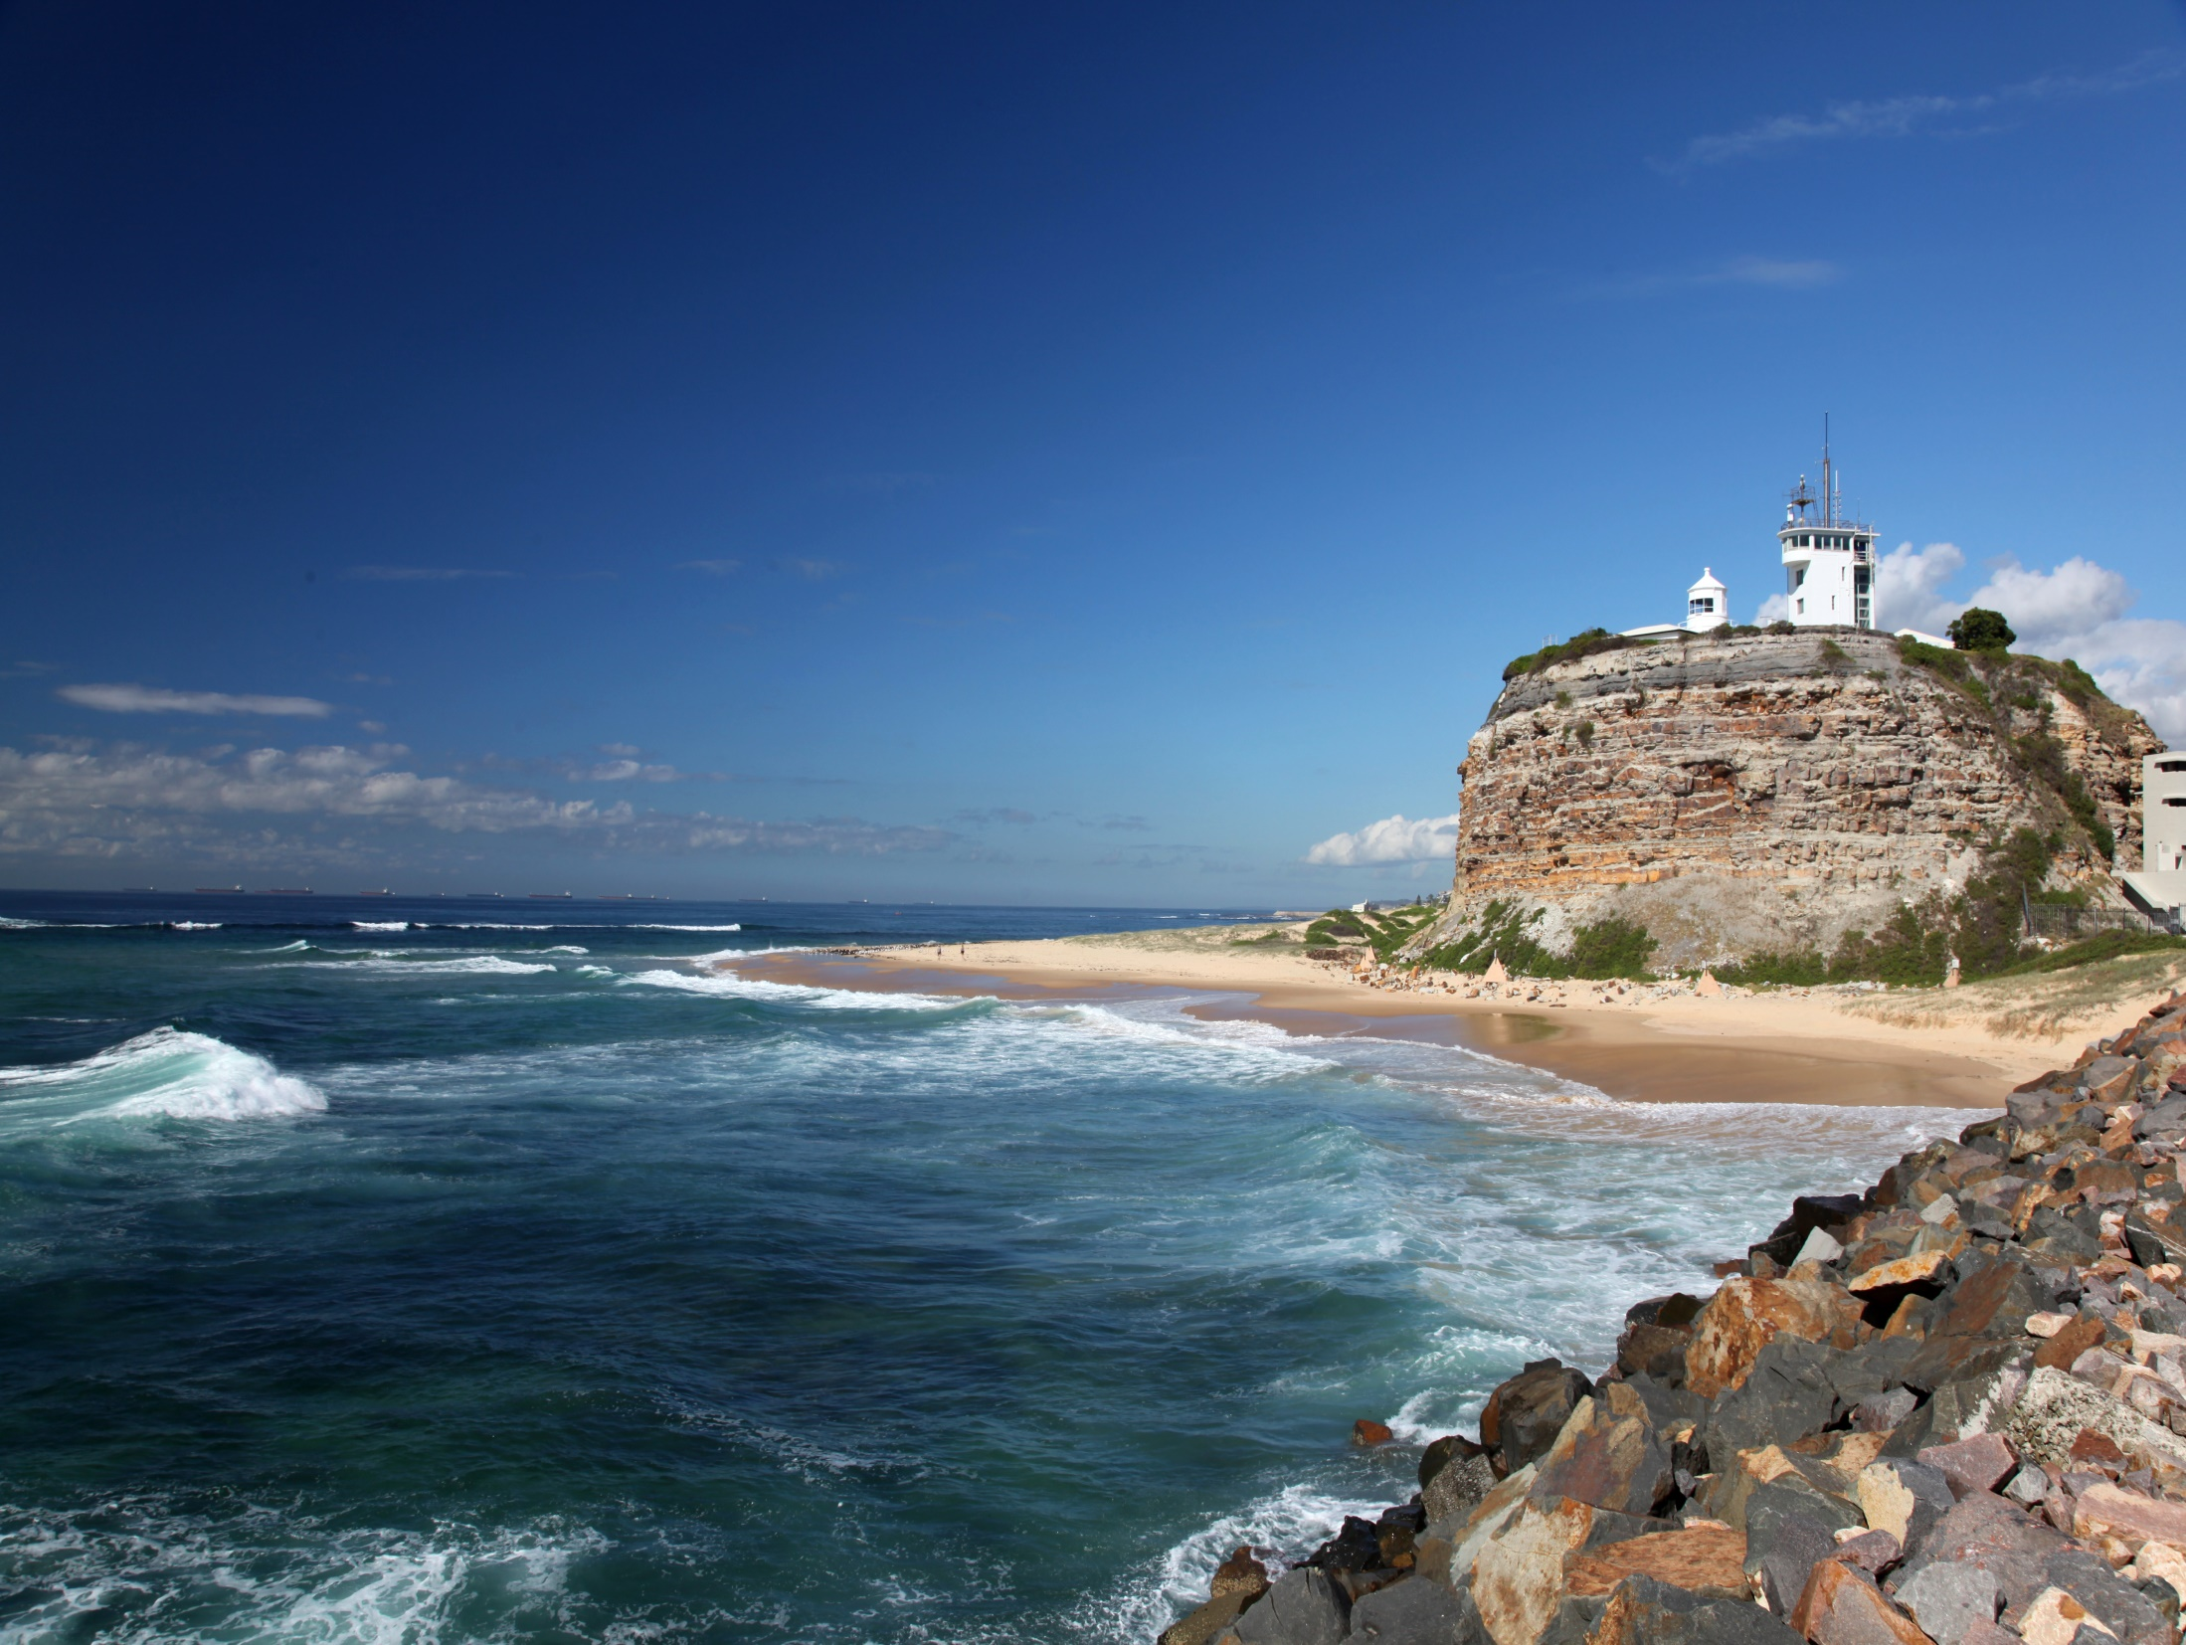
CONTEXT
ECONOMIC TRANSITIONS
What comes after the mining boom?
How to maintain economic growth?
A: Focus on where we are the most productive
Need to ‘Think global, act local’
Global competition is rising

Slide 15
COMPARATIVE ADVANTAGES
WHERE DO OUR OPPORTUNITIES LIE?
Our advantages:
Energy resources
Arable land and ‘agritourism’
Skilled workforce and high-value services
Advanced manufacturing (uses our high skills)
Our comparative disadvantages?
Unskilled, cheap labour (e.g. mass production)
Our high costs resemble the Germans & Swiss

Slide 16
ELECTRICITY: WATT ABOUT IT?
AN ELECTRIC DEBATE
Renewable electricity generation
New generation unprofitable (for now)
But longer-term ‘currents’ support renewables
Longer-term currents
Our manufacturing needs to be ‘advanced’
More may be needed to limit global warming
An opportunity to invest in these trends
Appropriate risk-management strategy

Slide 17
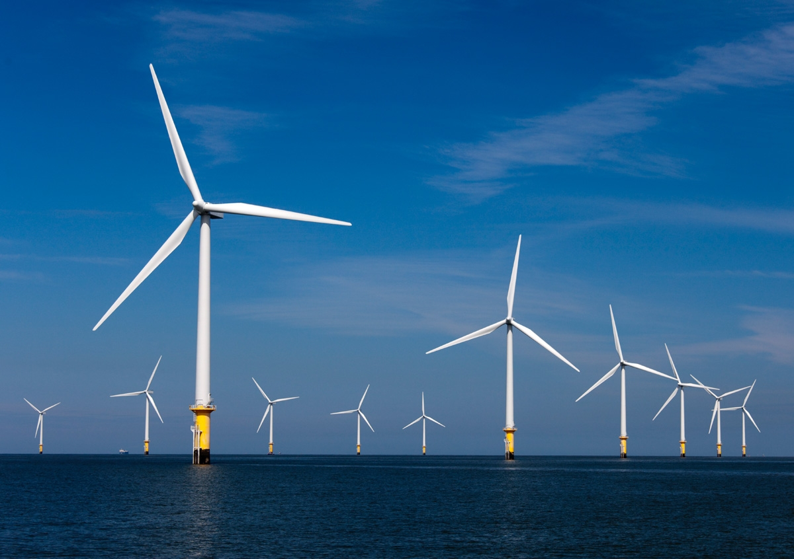
LONGER-TERM CURRENTS
Time for audience participation!
Butendiek (near Sylt)

Slide 18
GUESS WHO?
Clue: East meets West

Slide 19
ENERGY USAGE TRENDS
NOT SO DEMANDING
Economic development + climate concerns

Slide 20
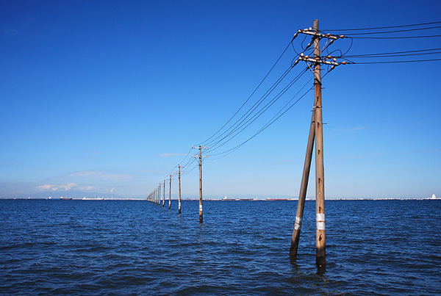
Even more audience participation!
Kisarazu

Slide 21
A RENEWED DEBATE
WHICH NATIONS?

Slide 22
RENEWABLES
A POWERFUL SURGE

Slide 23
INVESTMENT IN AUSTRALIAN PLANTS
‘SHOCKINGLY’ LOW

Slide 24
‘Servitisation’ of our economy

Slide 25
OUR DEMOGRAPHIC TRENDS
ENHANCE OUR ECONOMY’S ‘SERVITISATION’

Slide 26
Time again for audience participation!

Slide 27
WHOSE DEMOGRAPHIC TRENDS?
One of these is the largest democracy

Slide 28
ASIA’S DEMOGRAPHIC TRENDS
FURTHER BOOST TO ‘SERVITISATION’

Slide 29
THINK GLOBAL ACT LOCAL

Slide 30
DO HUNTER BUSINESSES HAVE THIS MINDSET?
HRF’s Hunter Pulse: a unique Regional asset

Slide 31
Hunter insights that matter

