Slide 1

Public Forum on ‘Transitioning to Renewable Energy’, Newcastle, 10 June 2015
Sustainable Energy Solutions for Climate Change
Dr Mark Diesendorf
Institute of Environmental Studies
University of New South Wales (UNSW)
Sydney, Australia
www.ies.unsw.edu.au
m.diesendorf@unsw.edu.au

Slide 2
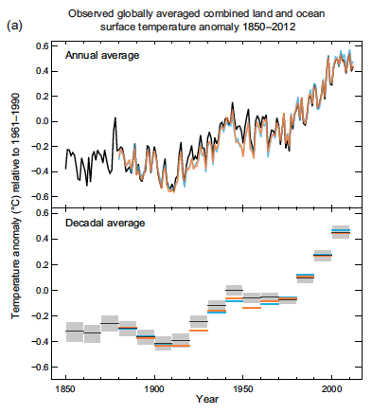
Trend in Annual and 10-Year Average Temperatures
1850−2012
Combined land & ocean surface data averaged over globe.
Source: IPCC (2013-14)
Source: IPCC (2013)

Slide 3
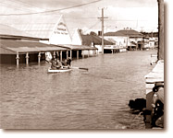
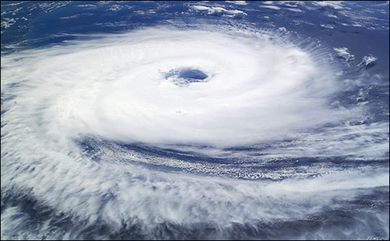
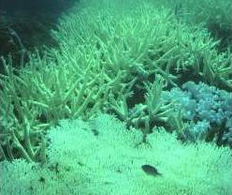
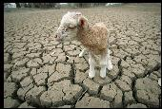

Our Climate is Changing!
3
Notes:
3

Slide 4
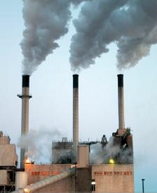

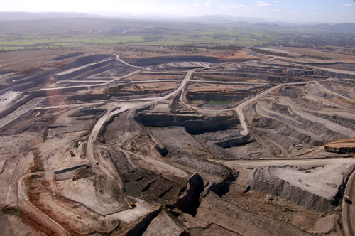
Impacts of Fossil Fuels
Global climate change
Air pollution and respiratory diseases
Water pollution
Land degradation
Few jobs in fossil fuels
Energy insecurity
  Peak in global oil production
  Peak in global coal in a few decades
Gas prices escalating in eastern Australia
LA teenager’s lungs

Slide 5
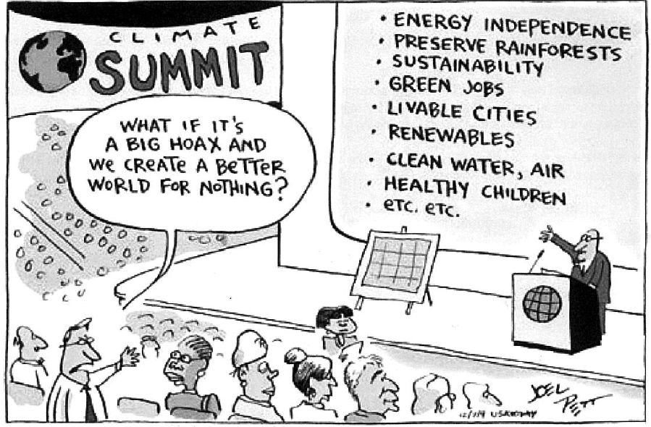
We need a transition to Sustainable Energy

Slide 6
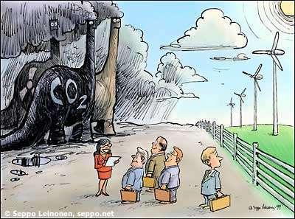
We can choose Sustainable Energy instead of Fossil Fuels
Reduction of wasteful demand
  Efficient energy use
  Energy conservation
  Managing peaks in demand
  with ‘smart’ systems
+
Renewable energy
  Wind
  Direct solar
  Hydro
  Marine
  Earth heat/coolth

Slide 7
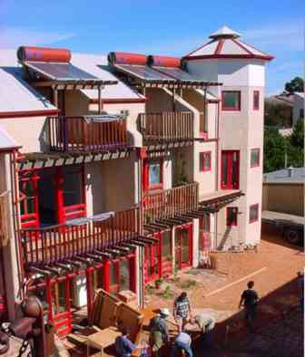
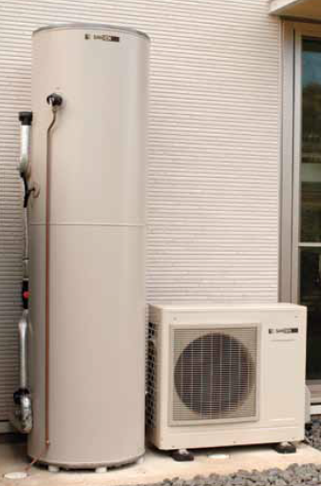
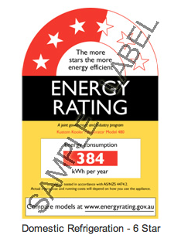
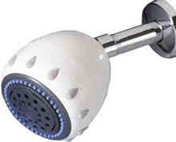


Energy Efficiency saves Energy and Money
Water efficient shower
Heat pump hot water
Ceiling fan
Christie Walk, Adelaide
LED lights

Slide 8

How can Renewable Energy replace Fossil?
Energy end-use at present | Energy end-use | Future renewable energy contribution
Electricity Currently mostly coal |  | Could be supplied entirely by renewables in Australia & many countries within a few decades.
Transport Currently mostly oil |  | Electric vehicles for urban transport; inter-city high-speed rail; biofuels (initially) for rural vehicles & some air travel.
Heat (non-electrical) Currently mostly gas |  | Low temperature heating & cooling from direct solar & electric heat pumps; high temperature from renewable electricity
Electricity will play a greater role in heating/cooling and transport.
Hence this presentation focuses on electricity.

Slide 9
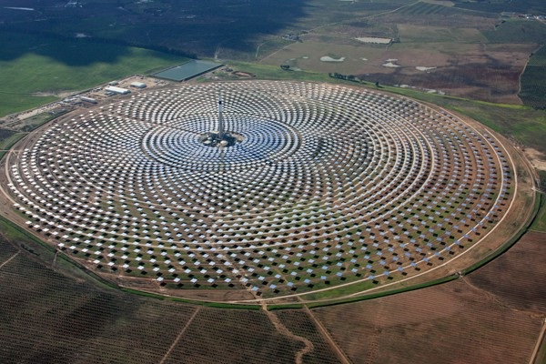
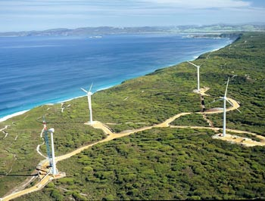
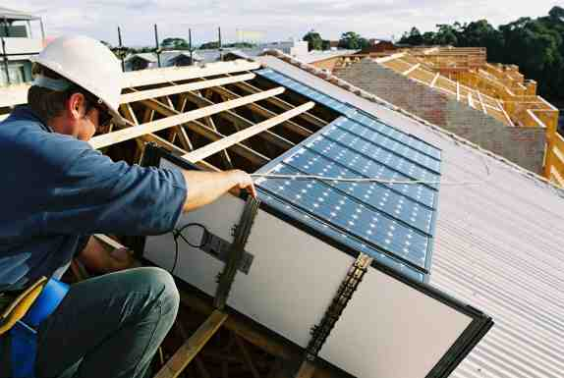
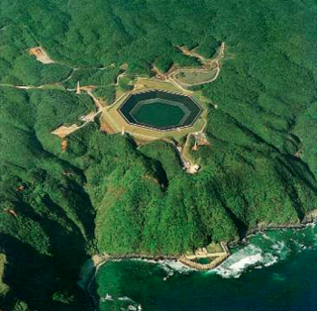
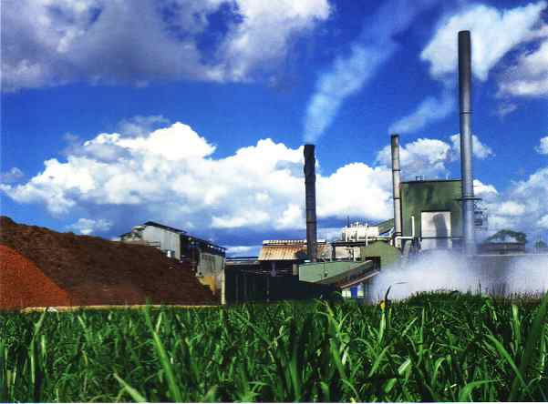
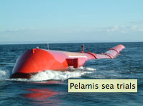
Renewable Electricity
Wind
Biomass
Solar PV
Concentrated solar thermal
Hydro
Wave?
Geothermal electricity?
Australia has the lot!
CST with thermal storage, Spain
Wind, Albany, WA
PV solar tiles, Sydney
Seawater pumped hydro, Japan
Jobs in manufacturing, installation, grid connection; a few in operation & maintenance
Wave
Bioenergy, Rocky Point, Qld

Slide 10
Countries and States with Strong Renewable Electricity Targets
Country/state | 2013 or 2014 Renewable Electricity | Target
Denmark | 39% of electricity consumption from wind + bioenergy from ag. residues | 100% renewable electricity and heat by 2035; 100% transport 2050
Germany | 26% from renewables. | At least 80% renewable electricity by 2050
Scotland | 44% from renewables, mostly wind followed by hydro | 100% renewable electricity by 2020
China | Biggest wind capacity and solar hot water; biggest PV manufacture | 15% of all primary energy from ‘low-carbon’ by 2020
California, USA | About 24% in total from hydro, geothermal, wind, biomass, etc | 33% renewable electricity by 2020
Schleswig-Holstein, Germany | About 100% net in 2014 – mostly wind | 300% under discussion

Slide 11
Vested Interests are spreading False Myths about Renewable Energy (RE)
Myth: ‘Base-load power stations, either coal or nuclear, are necessary, and RE cannot provide them’
Myth: ‘Base-load power stations must run continuously as backup for RE’
Myth: ‘RE is too variable to make the predominant contribution to grid electricity supply without vast amounts of expensive electrical storage’
Myth: ‘RE is too expensive’
Myth: ‘RE is too diffuse to run an industrial society’
Myth: ‘RE is not ready to replace fossil fuels’
Myth: ‘RE is responsible for the big increases in electricity prices
Myth: ‘Wind & solar have severe environmental and health impacts’

Slide 12
Why the Attacks?
Renewable Electricity threatens big greenhouse gas emitting industries, state gov’t revenue, & utility business models
‘Merit Order Effect’ at wholesale (generation) level
  Wind farms, with very low operating cost, are displacing coal-fired power stations and reducing wholesale price of electricity, South Australia, Germany, Denmark
‘Death Spiral’ at distribution/retail level
  Growth in rooftop solar PV and increased energy efficiency are reducing demand for grid electricity
Result
  Utilities & big business lobbying federal & state governments to stop growth in RE
  Government policies try to stop growth of RE
  False myths disseminated by malicious and lazy media

Slide 13
Mythbusting by Two Methods
Practical experience
  Denmark: wind supplied 39% of electricity consumption in 2014
  South Australia: about 33% wind + 6% rooftop solar PV in 2014
Hourly computer simulations of demand and supply by 80−100% renewable electricity in many countries
  Over 30 studies of states/provinces, countries, regions and whole world
  These find that renewable electricity systems can be just as reliable as conventional systems
  Predominantly renewable electricity systems are affordable
  Myths hostile to RE are busted

Slide 14
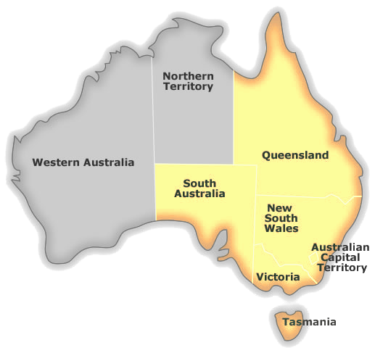
UNSW Simulation Models of 100% Renewable Electricity (RE) in National Electricity Market (NEM)
(Journal papers by Elliston, MacGill and Diesendorf 2012, 2013, 2014)
Hourly data on electricity demand, solar & wind for NEM, initially spanning 2010
All commercially available RE technologies scaled up
Simulation model built by Ben Elliston: hourly time-steps through 2010, balancing supply and demand; maintaining reliability
Cost projections to 2030 by BREE (2012)
Economic optimal mix evaluated
Simplified transmission model
Comparison fossil fuelled scenarios

Slide 15
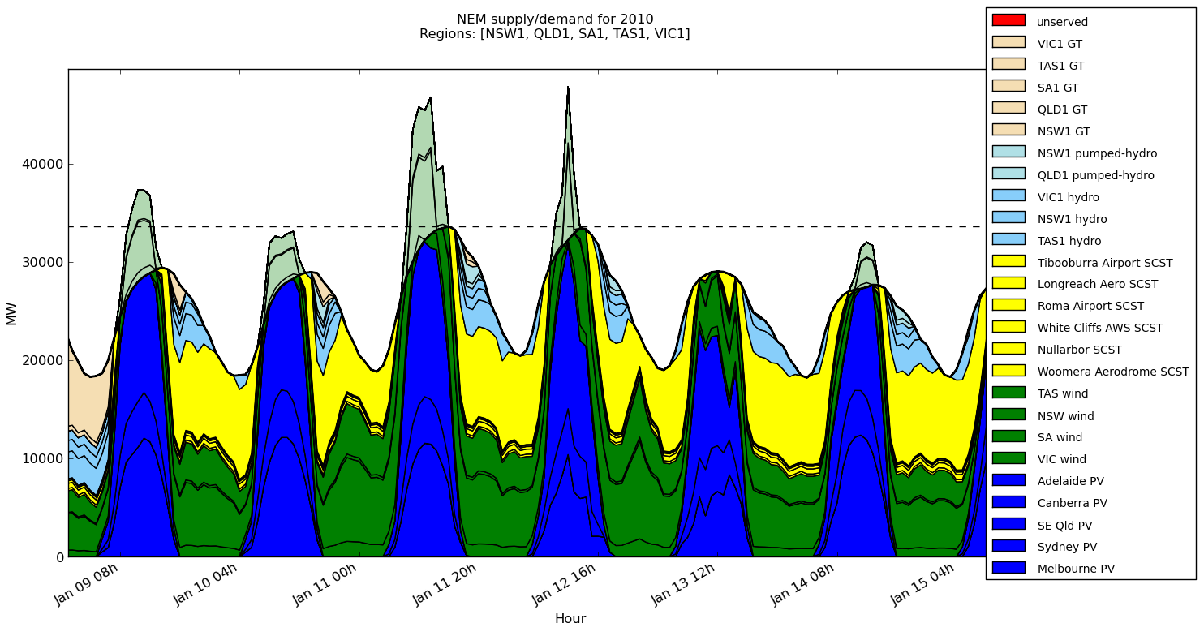
Supply and Demand for a Typical Week in Summer 2010 – Optimal Mix of RE in NEM
GT
Hydro
CST
PV
Wind
Supplying base-load demand is easy in summer; negligible gas turbine energy used.

Slide 16
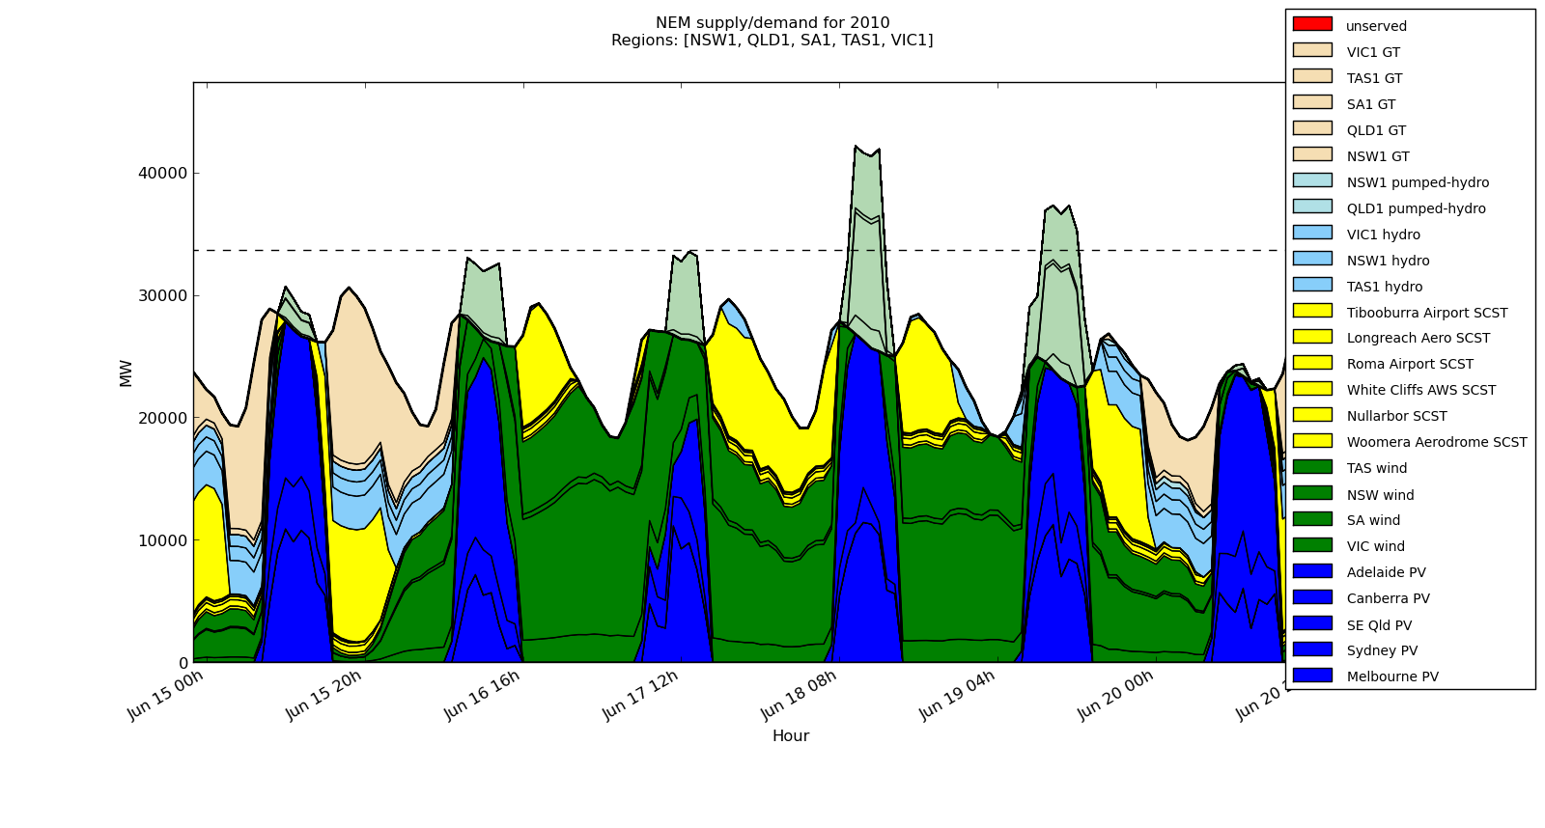
Supply and Demand for a more Challenging Period in Winter 2010 − Optimal Mix of RE in NEM
PV
GT
Wind
Hydro
In calm winter evenings following cloudy days, gas turbines & demand management are important.

Slide 17
100% RE Least-Cost Energy Generation Mix 2030 projected costs by BREE
5% Discount Rate; no extra transmission
Note: Variable RE contributes two-thirds of annual energy and reliability is maintained!
Technology costs projected to 2030 by BREE (2012).
GT is gas turbines burning renewable fuels; reduced to 2% by geographic dispersion of wind farms.
CST is concentrated solar thermal with thermal storage.

Slide 18
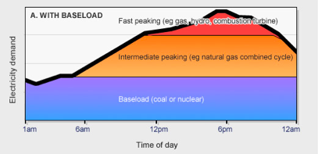

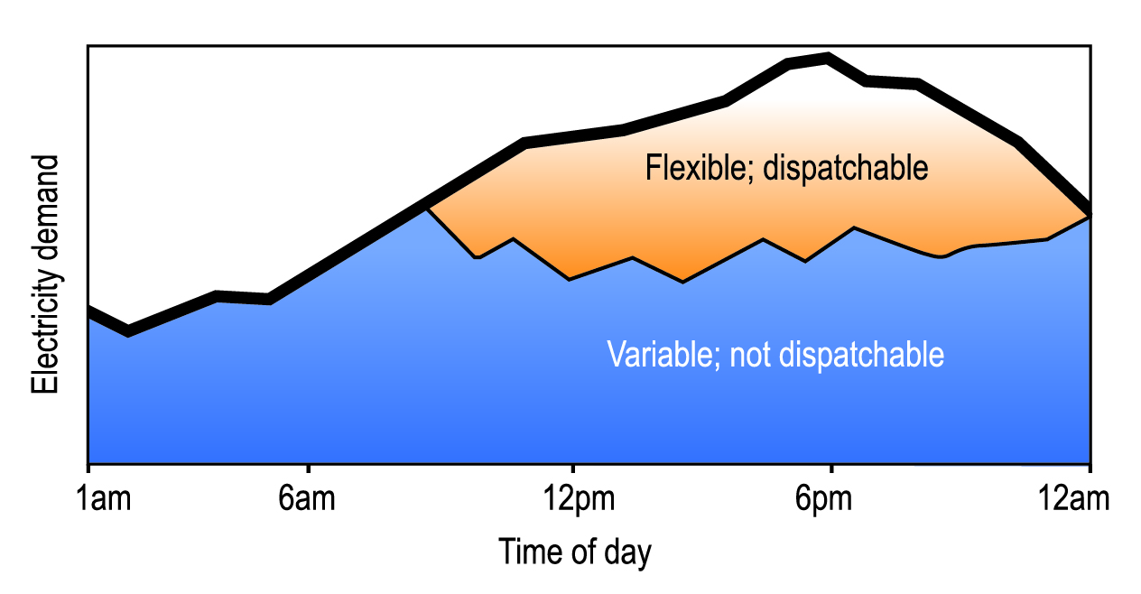
Myth: “Base-load power stations are needed”
Traditional concept
(base-load power stations supply base-load demand)
busted
New concept replaces traditional
100% RE without base-load power stations; variable + flexible stations meet demand reliably
Hydro; GT; CST
Wind; PV

Slide 19
Meeting Demand without Base-load Stations
Renewable electricity supplied by mix of variable plants (wind and PV without storage) and flexible/dispatchable plants (CST with thermal storage, hydro with storage, biofuelled gas turbines)
Flexible plants (together with improved weather forecasting) balance the fluctuations in power output from inflexible plants
Demand management in a ‘smart grid’ can also play an important low-cost role.
Key parameter is reliability of the whole supply-demand system, not reliability of individual technologies. Reliability criterion satisfied in all simulations: unmet annual energy < 0.002% of annual demand

Slide 20
UNSW’s Four Comparison Scenarios
None in AEMO (2013) study
Most efficient commercially available fossil power stations (no CCS); GHG emissions still 81% of existing system − unacceptable!
All gas (no CCS), base-load combined cycle and peak-load open cycle; GHG emissions 40% of existing − unacceptable!
Base-load coal with CCS (unproven technology) + peak-load gas turbines
Base-load gas with CCS (unproven technology) + peak-load gas turbines

Slide 21
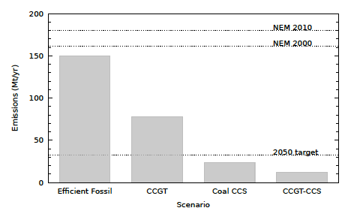
Annual CO₂ Emissions from 4 comparison Fossil Fuel Scenarios in NEM
Unacceptable emissions
Unproven technologies
Mostly coal
All gas
Coal
Gas

Slide 22
Summary: Economics of the Four
Fossil-Fuelled Comparison Scenarios
CCS is hypothetical carbon capture and storage; CCGT is combined cycle gas turbine
Unacceptable emissions
Unproven technologies
Efficient fossil:
100% RE competes either if CO₂ price is $50-100 per tonne, or fossil subsidies of $10 billion p.a. transferred to RE
All gas: 100% RE competes if domestic gas prices increase to near export prices; already happened in Qld.
Fossil + CCS:
100% RE competes almost everywhere

Slide 23
Myth: “Renewable energy is too diffuse”
Back-of-envelope with NEM Electricity Demand 250 TWh/y
Wind farms provide 50% of electricity = 125 TWh/y
Rooftop solar PV supplies 25% of total electricity demand: 0 land area
Hydro and gas turbines provide 10% of electricity & occupy negligible additional land if GTs fuelled by ag. & plantation forestry residues
On-ground solar supplies 15% of electricity
Total land area occupied = 0.056−0.086%
of NEM states’ total land area

Slide 24
Busted Myths about Renewable Energy
Myth: ‘Renewable energy cannot provide base-load power.’ Myth is based on false notion that base-load demand must be supplied by base-load power stations − BUSTED as irrelevant
Myth: ‘Renewable energy is too variable or intermittent to make the predominant contribution to grid electricity supply − BUSTED
Myth: ‘Coal-fired power stations must run continuously as backup’ − BUSTED by both experience & simulations
Myth: ‘Renewable energy is too expensive’ − BUSTED
Myth: ‘Renewable energy is too diffuse to run an industrial society’ − BUSTED
Myth: ‘Renewable energy is still immature’ − BUSTED

Slide 25
National Policies needed in Australia
Set stronger greenhouse targets
Re-introduce a carbon price, preferably as a tax rather than ETS
Terminate subsidies to production & use of fossil fuels (> $10B+ p.a.).
Increase LRET for 2020 and set much higher targets for 2025 & 2030
Keep ARENA & CEFC
Upgrade transmission system for large-scale RE: priority SA−NSW link (federal, NSW & SA governments)
Expand energy ratings for buildings, appliances & equipment; mandatory energy labelling and energy performance standards

Slide 26
Additional Energy/Climate Policies for NSW
Expand energy efficiency programs
Set NSW emissions reduction targets for 2020 2025, 2030 & 2050
Set targets for renewable electricity for 2020,2025 & 2030 & 2050
Hold Reverse Auctions, backed up with feed-in tariffs or contracts for difference, for large-scale RE
Government agencies to purchase ’green’ electricity
Upgrade local distribution networks for 2-way flows of electricity
Implement ‘smart’ grid; set fair electricity price structures
Make it illegal for electricity utilities to refuse feed-in of RE; set fair mandatory feed-in tariffs
Partially fund new transmission spine to SA
✔ Fund seeding grants & information for community RE projects

Slide 27
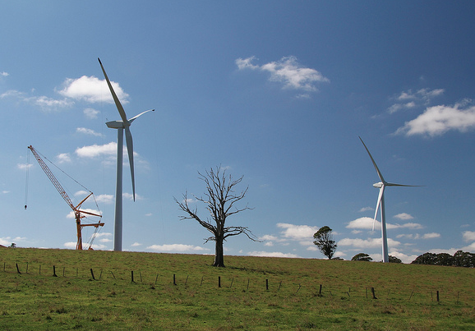
Hepburn Community Wind Farm near Daylesford, central Victoria
Community projects were foundation in Denmark & Germany
Hepburn is Australia’s first medium-scale community RE project
2 turbines, 4.1 MW total
Cooperative with about 2000 members
$9.6M from members +$1M Vic gov’t grant + $3M loan
Revenue returned to members and local community trust fund
Spin-off group Embark is facilitating other community projects in Australia
See <hepburnwind.com.au>

Slide 28
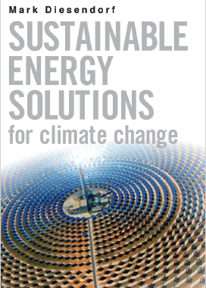
Further Information
Research papers & non-technical articles
http://www.ies.unsw.edu.au/our-people/associate-professor-mark-diesendorf
New book
Sustainable Energy Solutions for Climate Change, UNSW Press and Earthscan, 2014

